Slide 1
Language Processor
Introduction to Compiling

Slide 2
Compilers
A compiler translates (or compiles) a program written in a high level programming language that is suitable for human programmers into an equivalent program in target (sometimes machine) language that is required by computers
During this process, the compiler will also attempt to spot and report obvious programmer mistakes
Compiler
Source program
Target program
Error messages
Warnings

Slide 3
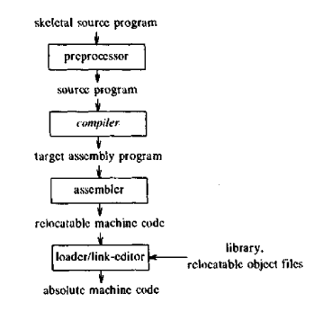
A Language Processing System

Slide 4
Advantage of using HLL
The notation used by programming languages is closer to the way humans think about problems
Programs written in a high-level language tend to be shorter than written in machine language
Same program can be compiled to many different machine languages and, hence, be brought to run on many different machines

Slide 5
Disadvantages of HLL
high-level language programs automatically translated to machine language may run somewhat slower than programs that are hand-coded in machine language
So, some time-critical programs are still written partly in machine language

Slide 6
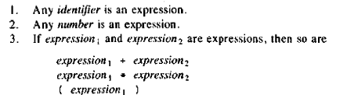
Analysis and Synthesis of the source program
Linear/Lexical Analysis or Scanning
Hierarchical/Syntax Analysis or Parsing
Semantic Analysis
Role of recursion

Slide 7
The phases of the compiler
Source program
Lexical Analyzer
Syntax Analyzer
Symbol Table Manager
Semantic Analyzer
Error Handler
Intermediate Code Generator
Code Optimizer
Code Generator
Target program

Slide 8
The phases of the compiler
Need- Job of compilation is difficult
Efficiency
Modularity
Conceptually, these phases operate in sequence though in practice, they are often interleaved,
Each phase except the first takes the output from the previous phase as its input

Slide 9
Phases… Symbol Table Management
Name of Identifier | Type | Scope | Lexical Value | Location in memory
Name of Procedure | Number and types of arguments | Method of passing each argument | Return Type if any

Slide 10
Phases…Error detection & Reporting
Compilation should proceed
Compiler should not stop

Slide 11
Phases…
Lexical analysis: This is the initial part of reading and analyzing the program text: The text is read and divided into tokens. Ex- a variable name, keyword or number
Syntax analysis: takes the list of tokens produced by the lexical analysis and arranges these in a tree-structure called the syntax tree (Syntax tree vs. parse tree)

Slide 12
Phases…
Semantic Analysis: analyses the syntax tree to determine if the program violates certain consistency requirements,
Intermediate code generation: The program is translated to a simple machine-independent intermediate language
Three Address Code- max 3 operands
2 operators
Temporary name
Same instruction with fewer names

Slide 13
Phases…
Code Optimization- improves intermediate code to give faster running machine code
Code generation: The intermediate language is translated to target code or assembly language for a specific machine architecture
front end depends on source language
Backend depends on target machine
Literal Table

Slide 14
position:= initial + rate*60;
:=
id1 +
id1:=id2+id3*60 id2 *
id3 inttoreal
:= temp1:=inttoreal(60)
id1 + temp2:=id3*temp1 temp3:=id2+temp2
id2 * id1=temp3
id3 60
Semantic Analyzer
Lexical Analyzer
Syntax Analyzer
Intermediate Code Generator

Slide 15
temp1:=id3*60.0
id1:=id2+temp1
MOVF id3,R2
MULF #60.0,R2
MOVF id2,R1
ADDF R2,R1
MOVF R1,id1
Code Optimizer
Code Generator

Slide 16
Interpreter
Performs operations of the source program
Lexing, parsing and Semantic analysis are done
The syntax tree is processed directly to evaluate expressions and execute statements
An interpreter may need to process the same piece of the syntax tree (loop) many times and, hence, interpretation is typically slower than executing a compiled program
Writing an interpreter is often simpler than writing a compiler
The interpreter is easier to move to a different machine
Used to execute command languages

Slide 17
Compiler vs. Interpreter
Choice is a compromise between speed and space
Useful during program development
Do less work on the program before execution starts, starts running the program more quickly
Closer to the source code than is compiled code, error messages can be more precise and informative
More Secure
Portable and produces portable code
Does not generate target code

Slide 18
Why learn about compilers?
to get an intuition about what their high level programs look like when compiled and to tune programs for better efficiency
The error reports are easier to understand when one knows about and understands the different phases of compilation
the techniques used for lexing and parsing can be used to handle any kind of structured text such as XML documents, address lists, etc..

Slide 19
Why learn…?
domain specific languages (DSL's) are gaining in popularity. A DSL is a language designed for a narrow class of problems
Examples are data-base query languages, text-formatting languages, scene description languages for ray-tracers and languages for setting up economic simulations
The target language for a compiler for a DSL may be traditional machine code, but it can also be another high-level language for which compilers already exist, a sequence of control signals for a machine, or formatted text and graphics in some printer-control language (e.g.PostScript)
All DSL compilers will share similar front-ends for reading and analyzing the program text

Slide 20
Applications of Compilers
Machine Code Generation
Format Converters/ Code converters
Silicon Compilation- automatically synthesizing a circuit from its behavioral descriptions in languages like Verilog or VHDL
Query Interpretation
Text Formatting

Slide 21
Cousins of the compiler
Preprocessors-Macro processor
File Inclusion
Rational Preprocessor
Language Extensions-Equel
Assemblers- Pass, Two pass assemblers..
Loaders- loading and link editing

Slide 22
Compiler Construction Tools
Parser Generators- CFG
Scanner Generators
SDT Engines-Intermediate Code
Automatic Code Generators- Template Matching process
Data Flow Engines- Code Optimization

